Slide 1

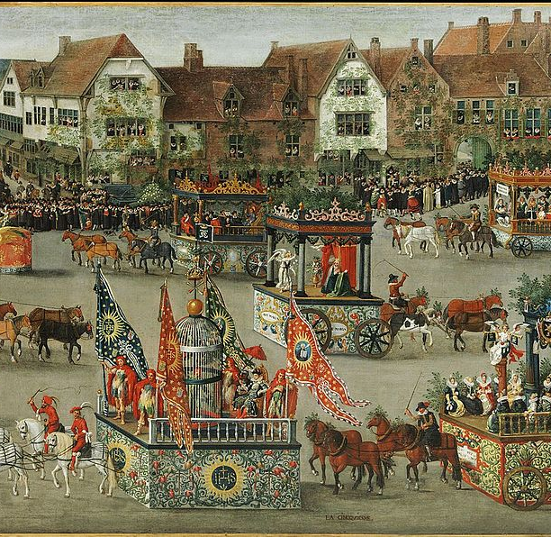
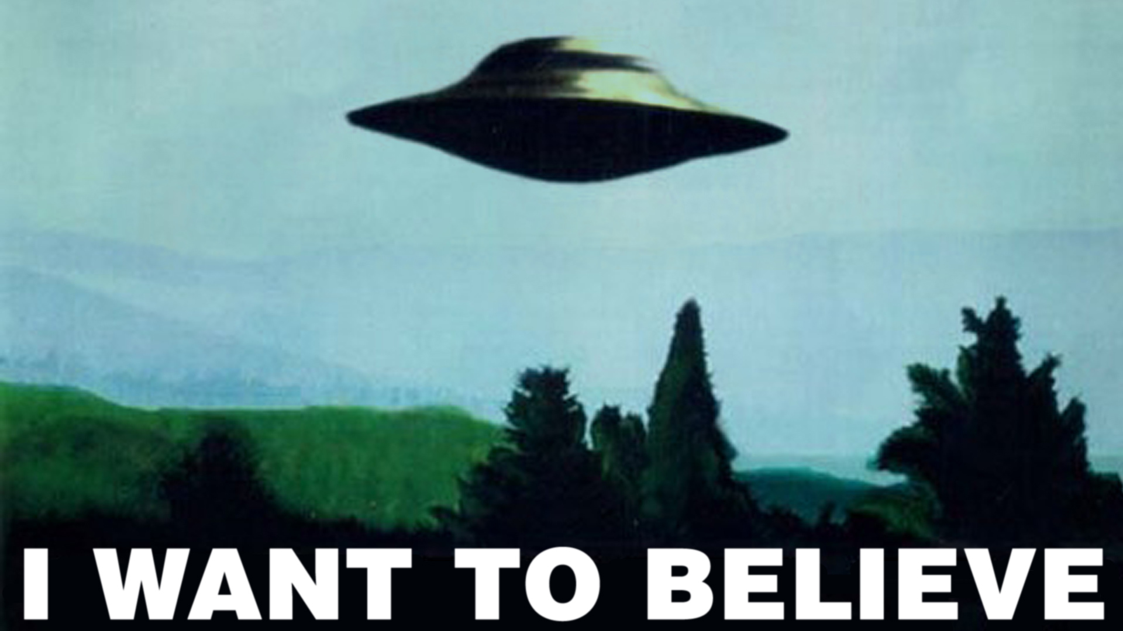
TRAVEL THROUGH TIME AND SPACE, PAST AND PRESENT, ANALOG AND DIGITAL, PHYSICAL AND SUPERNATURAL
Join this tour and experience tensions of historicity vs. presentism, fear vs. festivity, individual vs. social, and a host of other celebrations of ambivalence!
Tour sites include:
The House of Eternal Return (Santa Fe, NM)
The Triumph of Isabella, an Immersive Experience
National Historic Oregon Trail Interpretive Center and Tamástslikt Cultural Institute
The Mothman Festival and other Monster sites across the United States!
Touristic Tensions
Exploring Immersive Experiences of Either/Or and Both/And
For trip details and pricing contact your travel agent
DAN SMITH: smit2030@msu.edu or @danaturg on Twitter

Slide 2
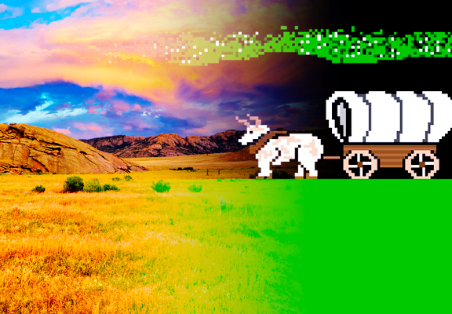
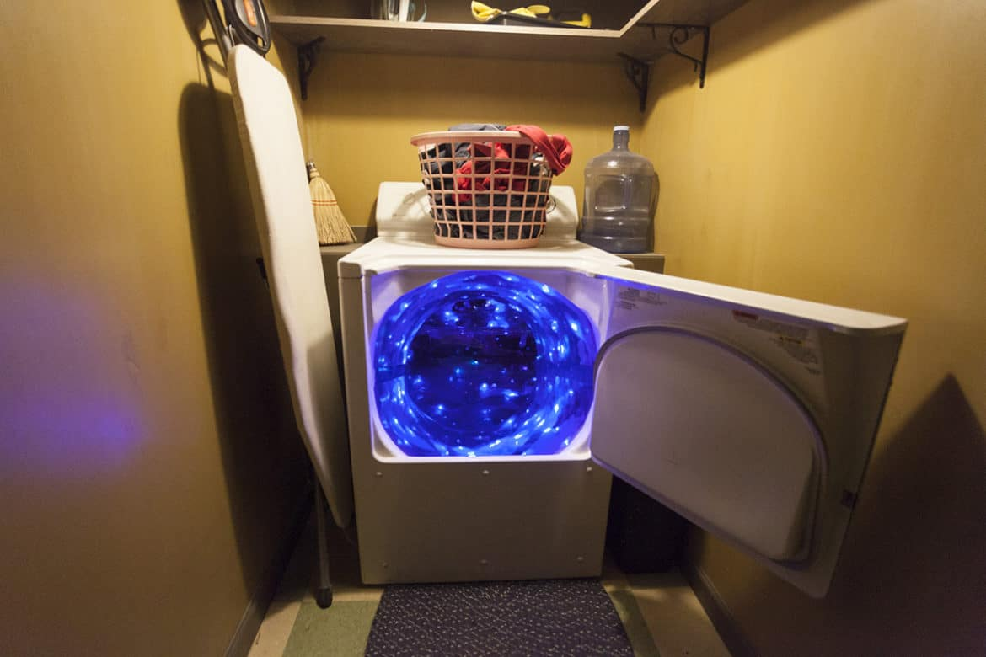
FEAR/FESTIVITY
FACT/FICTION
PAST/PRESENT
MEOW WOLF
The House of Eternal Return, as Margaret Werry notes, presents an immersive experience that is both individual and social. While patrons of varying social backgrounds and political beliefs encounter one another in this attraction, “its elective dramaturgical architecture ensures that patrons never have to engage together with any content that might challenge” (Werry 11). Explore the tension between avant-garde art and late capitalism!
THE TRIUMPH OF ISABELLA
Working against the pseudo-historicity of Renaissance Faires, Christen Mandracchia explores the 1615 Ommegang of Brussels through visual evidence. This immersive experience queries problems of history and representation. Embracing digitization in ways that run counter to the “anti-technological ideology” of Renaissance Faire culture (8), this portion of our journey enhances understanding of historical performance.
OREGON TRAIL
Jacob Rorem is our guide as we visit the National Historic Oregon Trail Interpretive Center and Tamástslikt Cultural Institute, which offer contrasting views of the history of the Oregon Trail as well as contrasting experiences of immersion. While the National Historic Oregon Trail Interpretive Center invites visitors to imagine themselves as emigrants (much like the Oregon Trail computer game), Tamástslikt positions visitors as guests learning about the effects of settler colonialism on indigenous cultures.
MONSTER SITES
Experience the paradox of fear and festivity as Sara Brooke Christian introduces us to the unusual world of cryptid tourism. Fans of Coast to Coast AM Radio and X-Files monster of the week episodes will revel in this exploration of the Mothman Festival, the Fouke Monster, and the lake monster Champ. To optimize your experience, screen The Legend of Boggy Creek and The Mothman Prophecies, and consider bringing along some HP Lovecraft stories for bedtime reading.

