Slide 1
The importance of being earnest
SCT 2019
Director: Dan Smith

Slide 2
Premise
Self-discovery and self-revelation lead to connection with others
  OR “If you can’t love yourself, how in the hell are you going to love somebody else?”
  Jack and Algy kill off their alibi alter-egos to be with Gwendolen and Cecily
  Gwendolen and Cecily study their diaries to support their romantic relationships
  Miss Prism reveals the truth about her past self, allowing three love relationships to flourish

Slide 3
Aesthetic: Cartoony, Campy, Over-the-top
Bright Colors, evoking Nostalgia
Victorian England, but stylized cartoon/camp version
Premiere was 1895

Slide 4
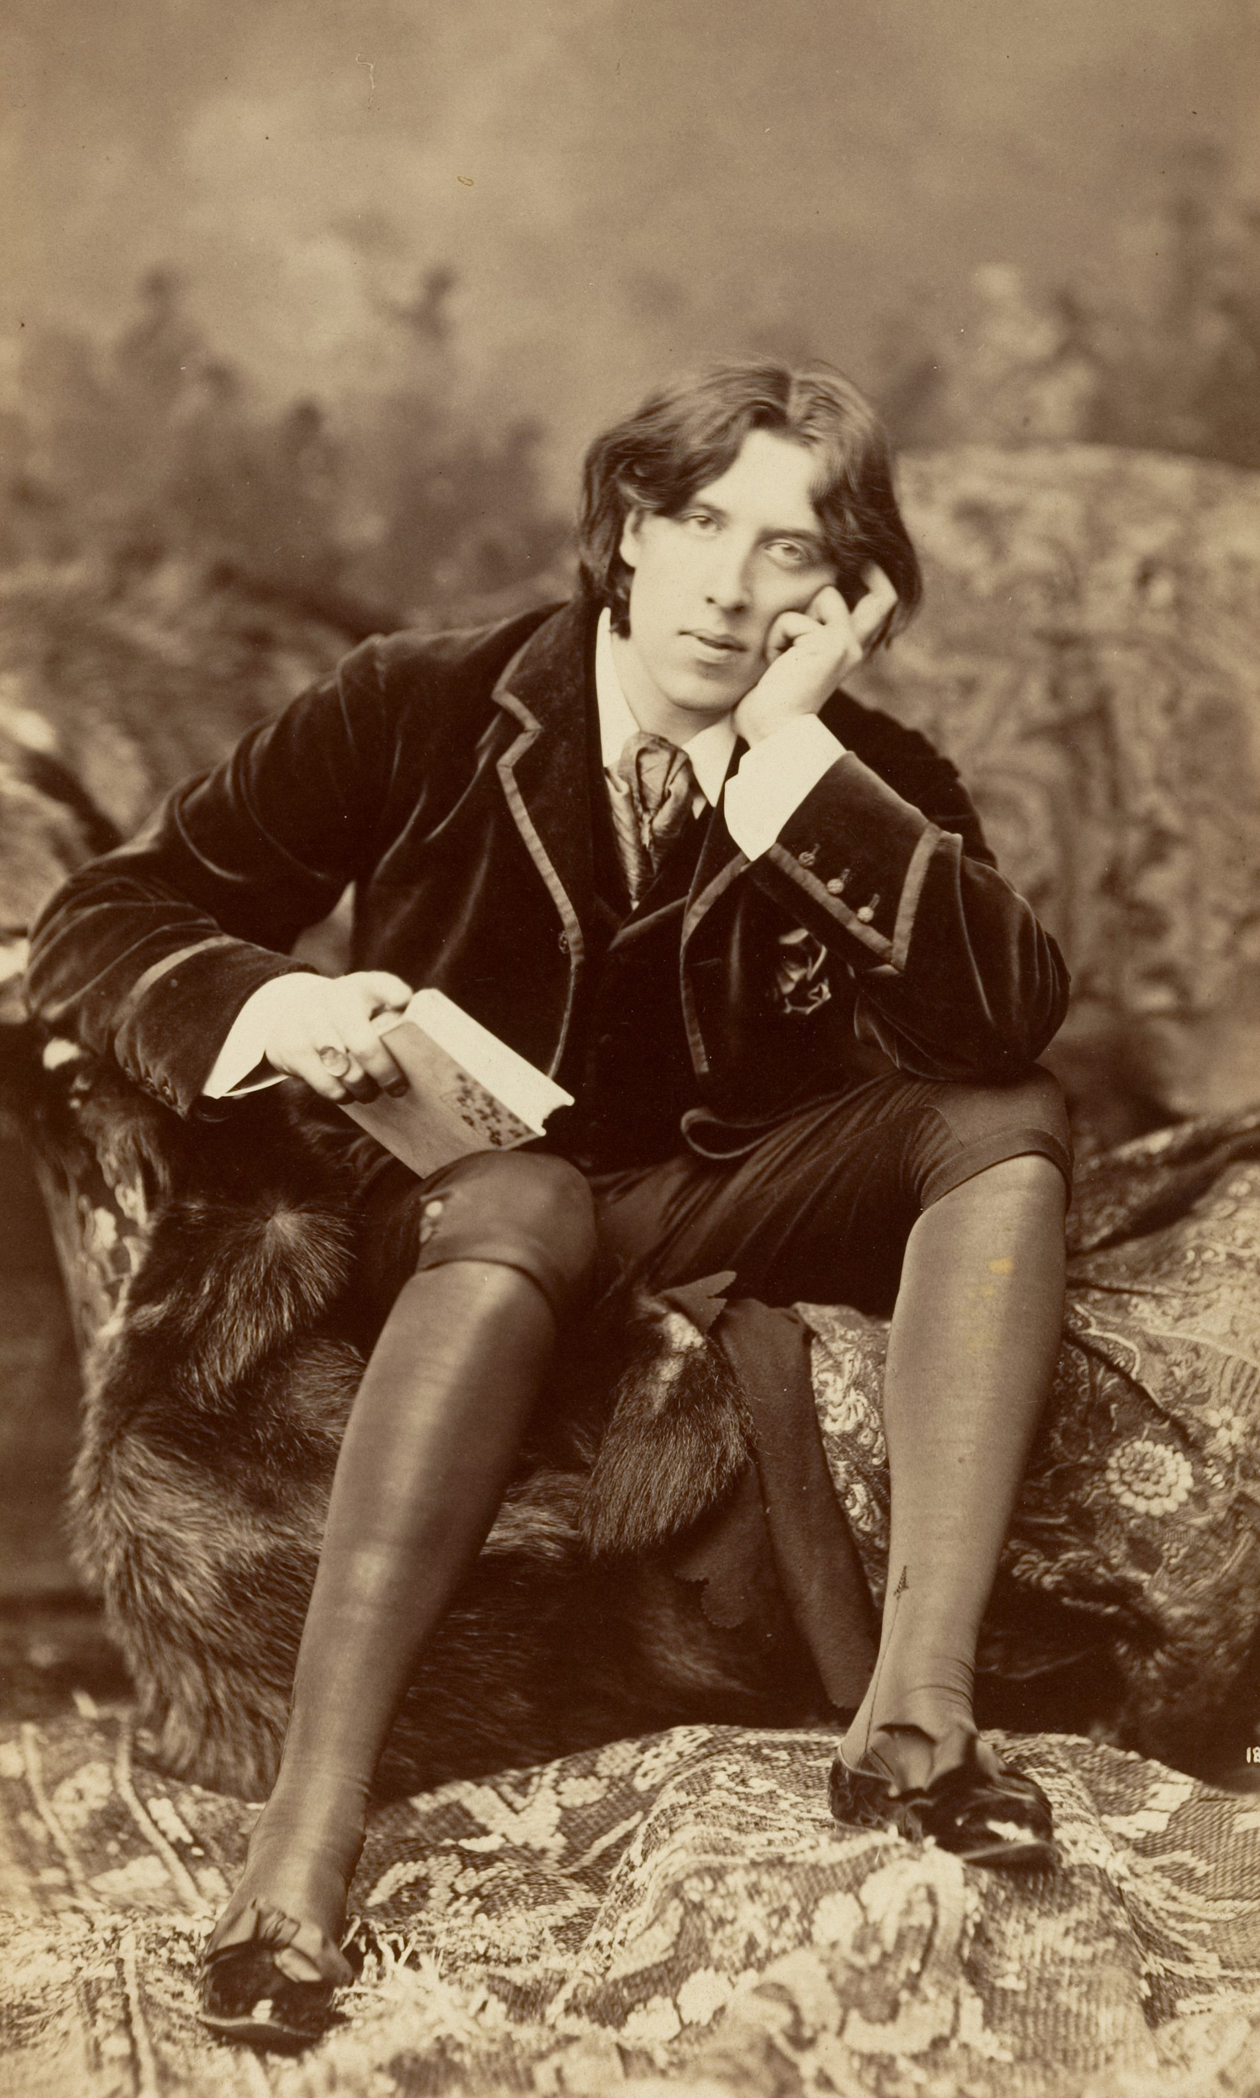
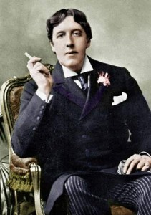
Oscar Wilde

Slide 5
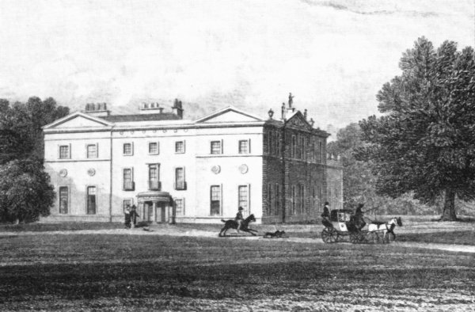
Woolton Hall

Slide 6

Manor House Garden

Slide 7

Manor House Garden

Slide 8
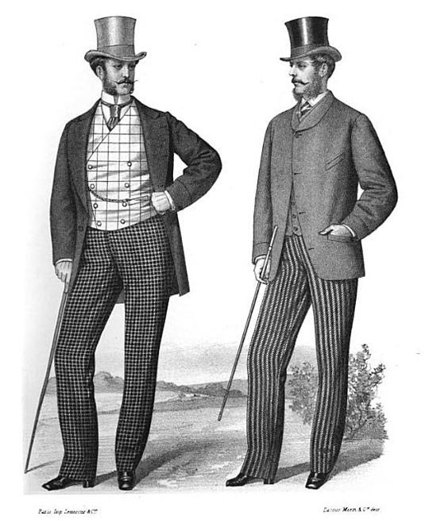
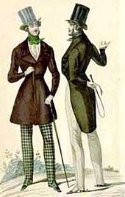
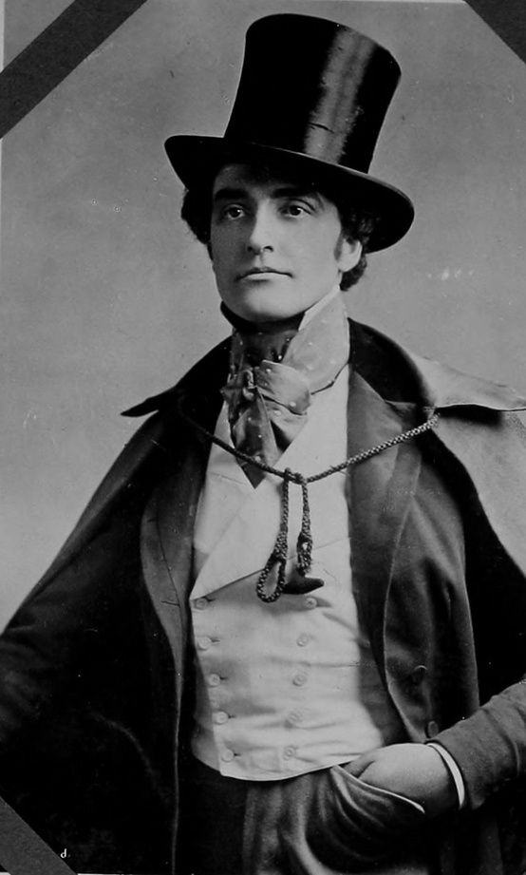
Victorian Dandy

Slide 9
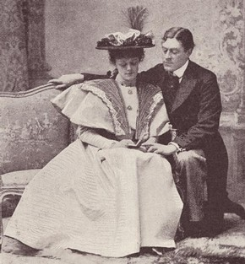
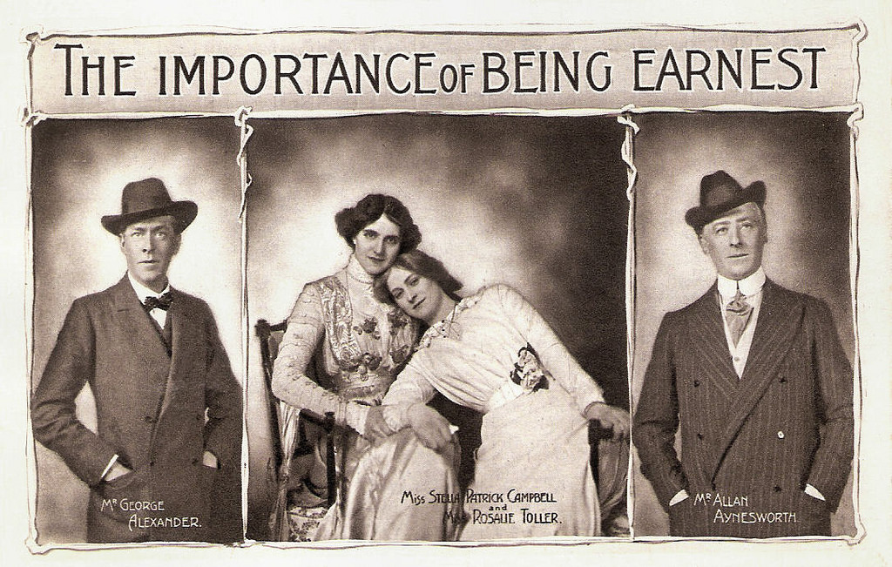
Original Production, 1895

Slide 10
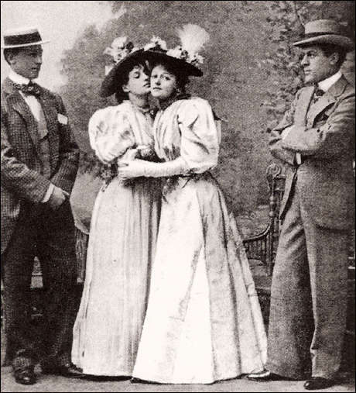
Original Production, 1895

Slide 11
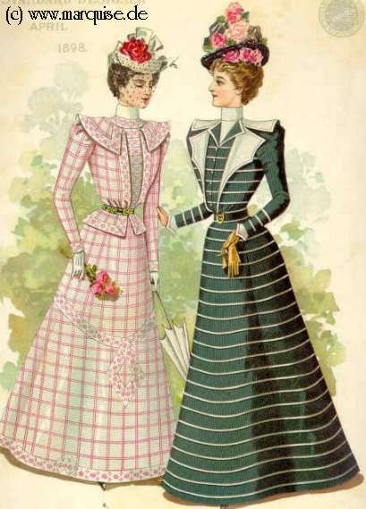
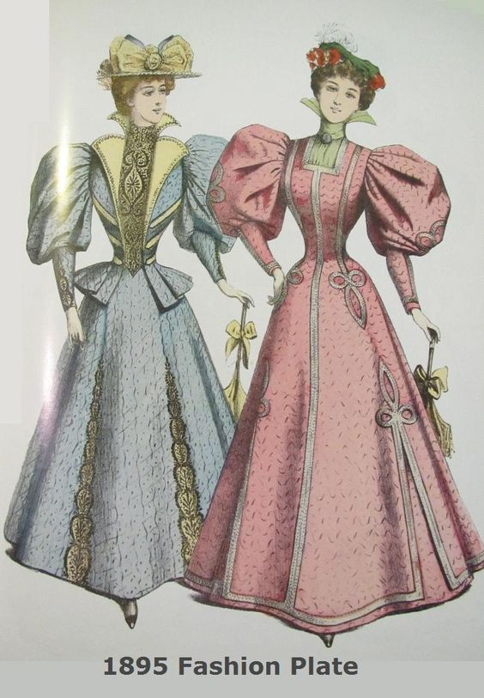

Slide 12
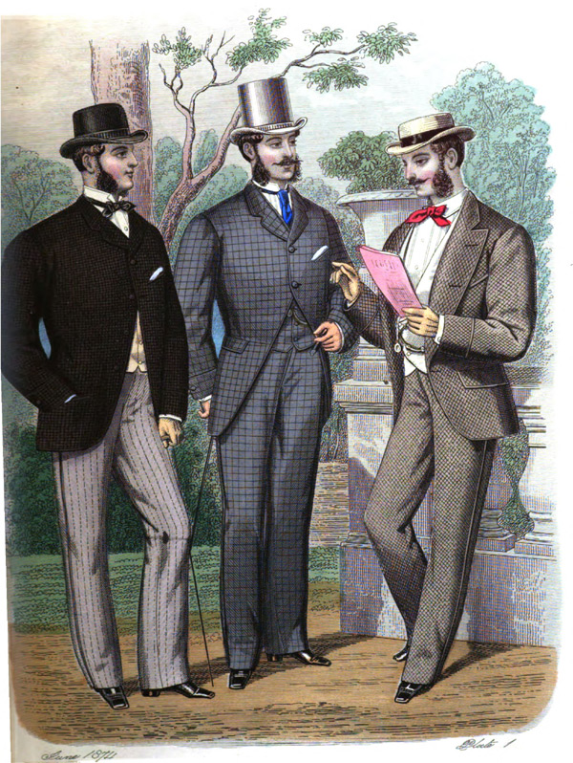
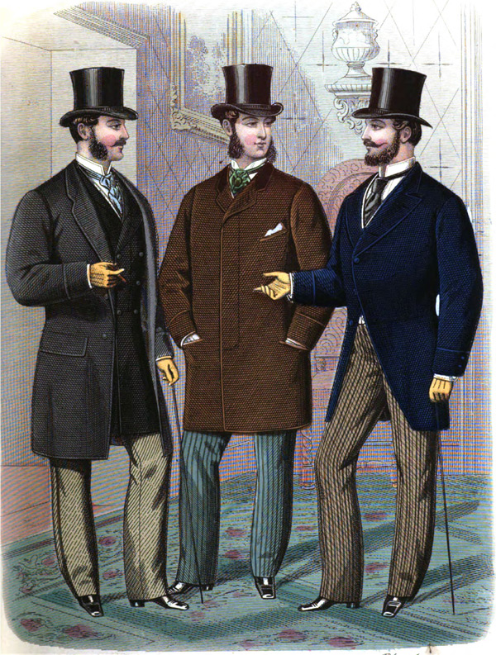

Slide 13
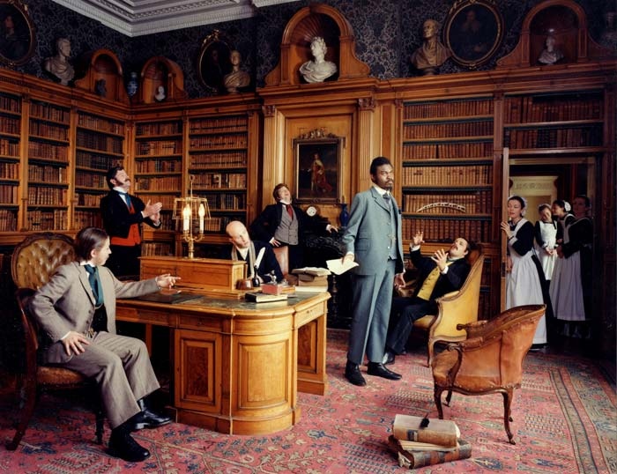
Yinka Shonibare, Diary of a Victorian Dandy

Slide 14
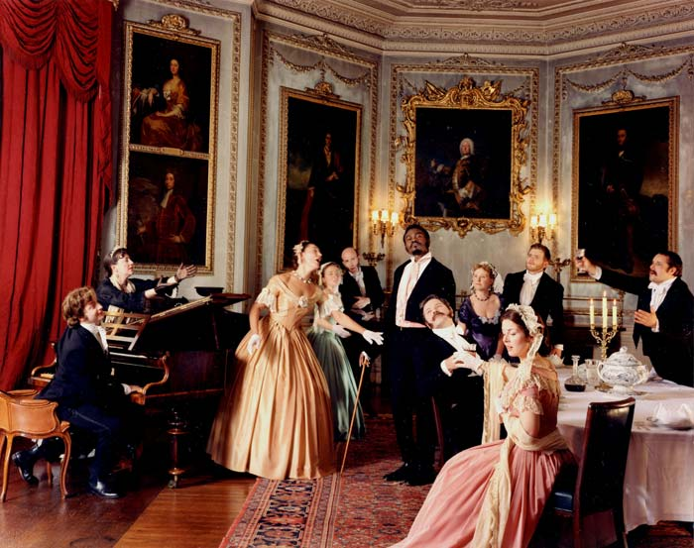

Slide 15
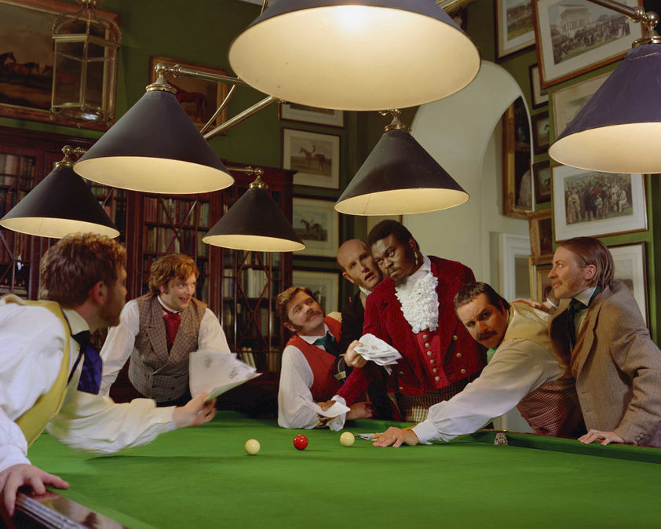

Slide 16
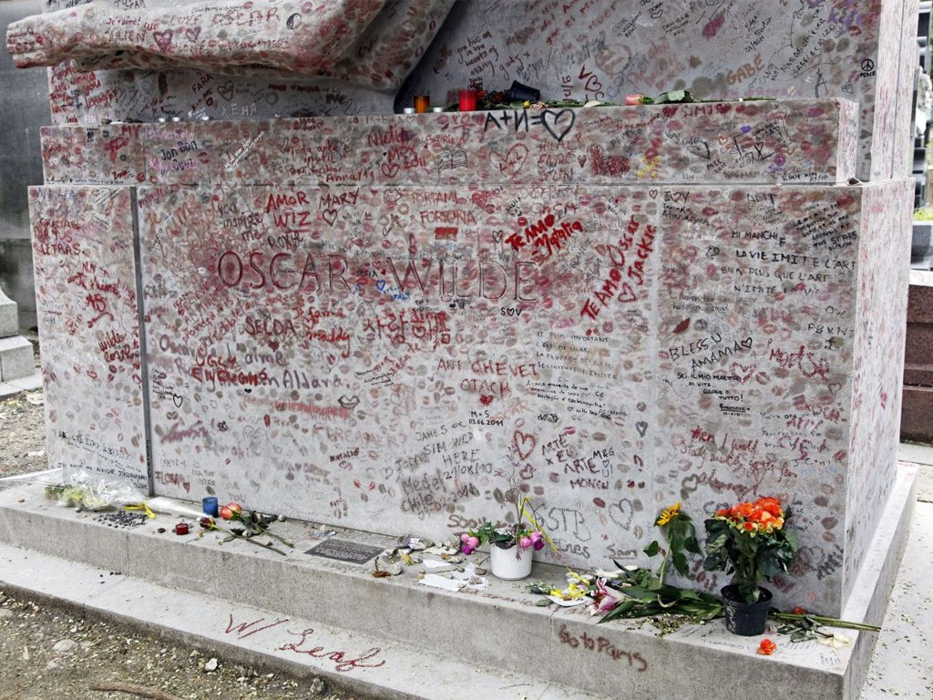
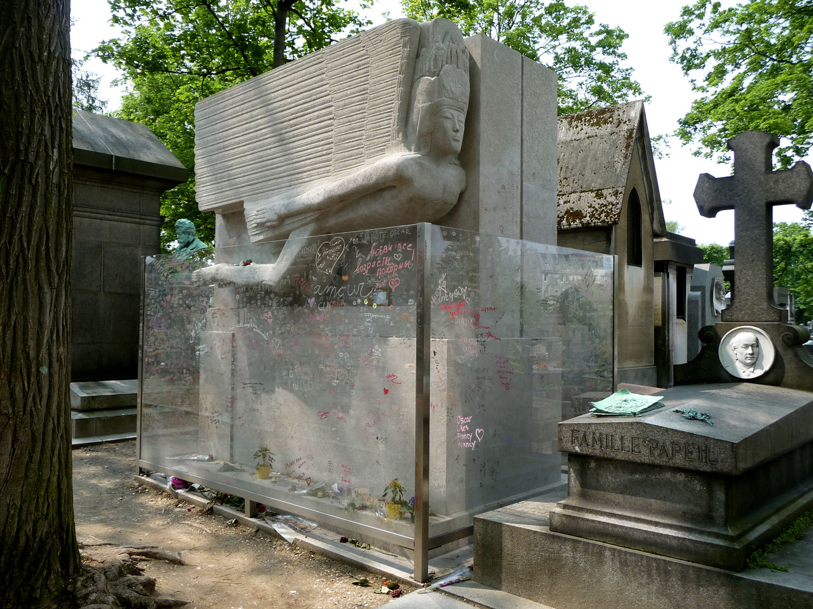
Oscar Wilde Tomb

