Slide 1
Sense and Sensibility
Director’s Image Research and Initial Thoughts

Slide 2
Premise
Loyalty leads to Happiness
Loyalty (to yourself and to those who deserve it) leads to happiness
  Dashwood sisters are loyal to each other
  Elinor’s loyalty to Edward is eventually rewarded
  Marianne is loyal to her family; learns to value Colonel Brandon’s loyalty and substance over Willoughby’s sex appeal and compatible tastes
  Colonel Brandon’s loyalty to Marianne is eventually rewarded
  Loyalty is more important than money, social class, or fealty; being true to yourself is more important than what other people think.
  Lesson: Substance is more important than Style

Slide 3
Concept: Sense and Sensibility at the Seashore
Beach party movies: goofy, but grounded in tropes of romantic comedy that are similar to Austen
Beach party aesthetic, like Austen, invokes Nostalgia
1960s: Frankie and Annette; Gidget
1960s-1970s: Brady Bunch, Gilligan’s Island
1980s-1990s: Rocky Road, Saved By the Bell, California Dreams
2000s: High School Musical 2

Slide 4
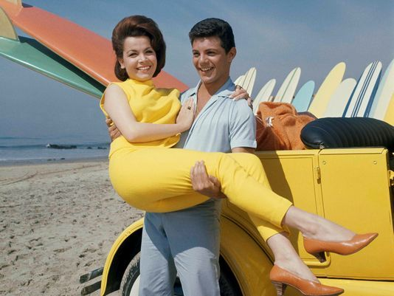
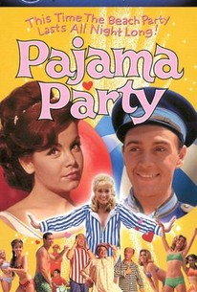

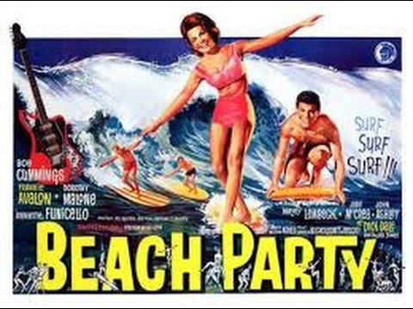
1960s Beach
Movies

Slide 5
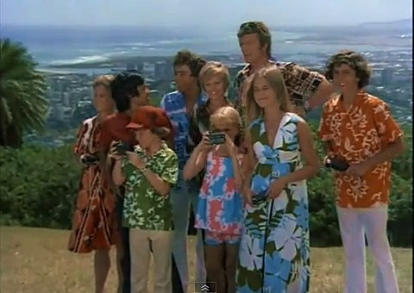
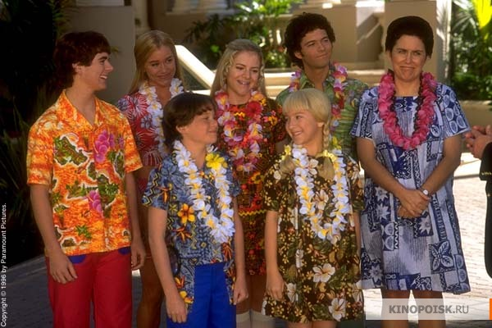
Brady Bunch Hawaii/A Very Brady Sequel

Slide 6
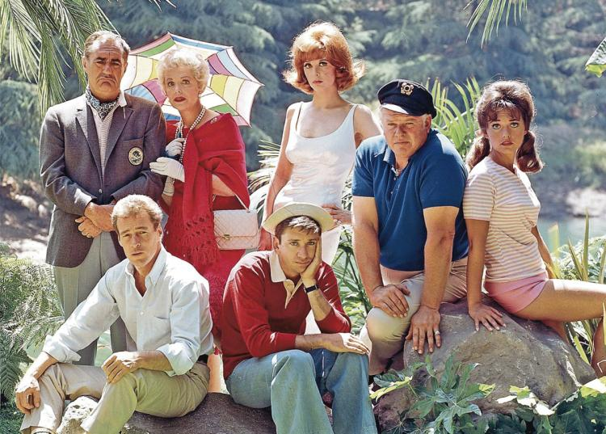
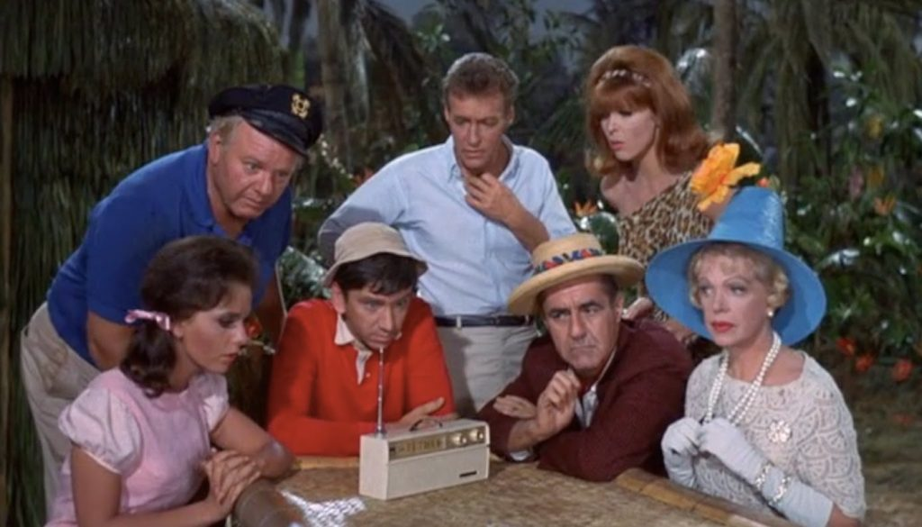
Gilligan’s Island

Slide 7
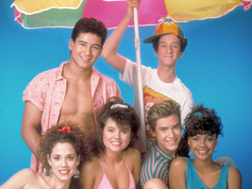
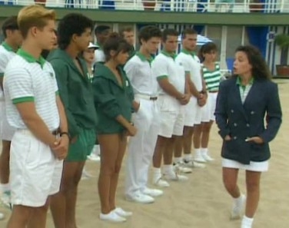
Saved by the Bell Beach Club Season

Slide 8
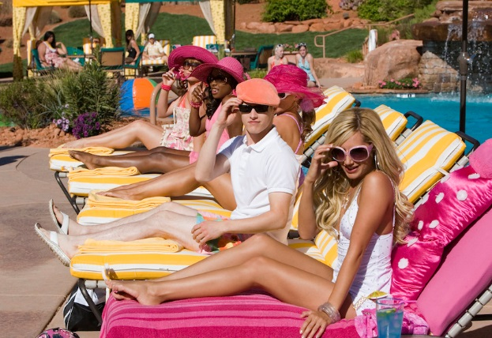
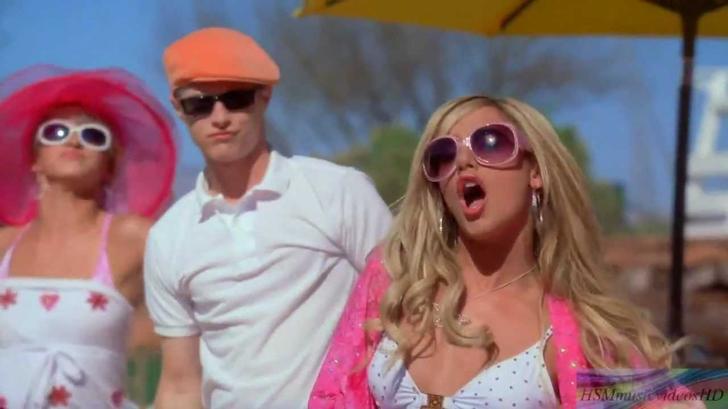
High School Musical 2: Beachy Country Club
Gossips: Sunglasses and Sun hats?

Slide 9
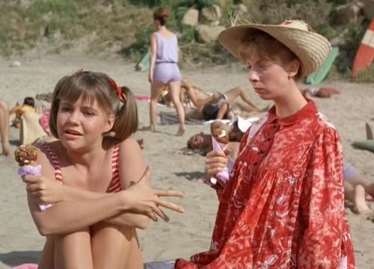
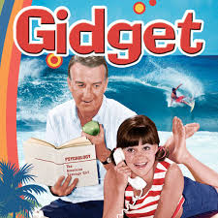
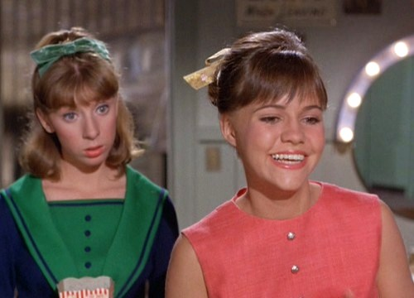
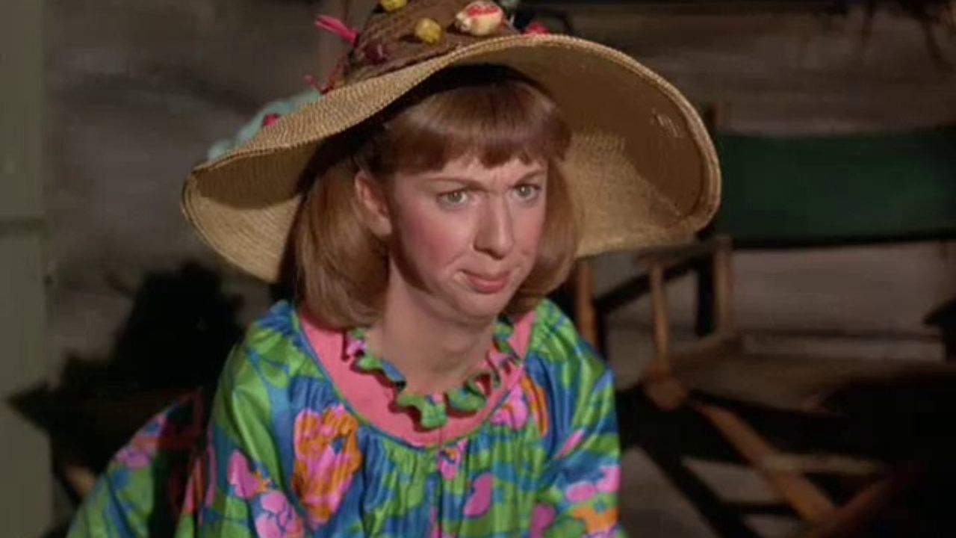
Gidget and
Larue

Slide 10
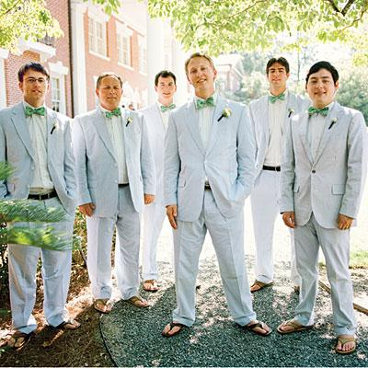
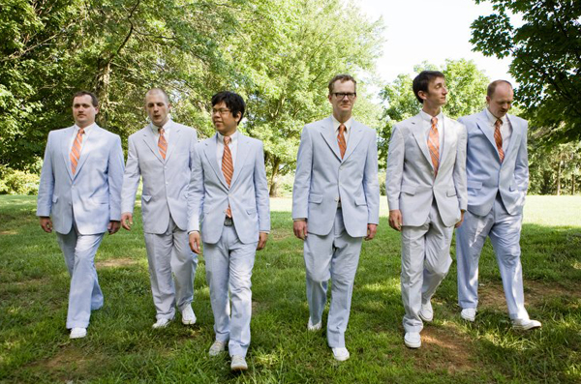
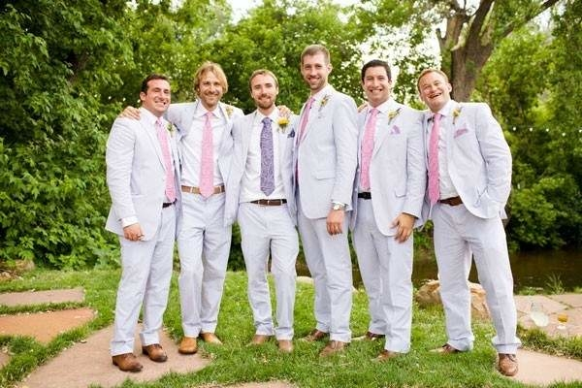
Seersucker Wedding Parties

Slide 11
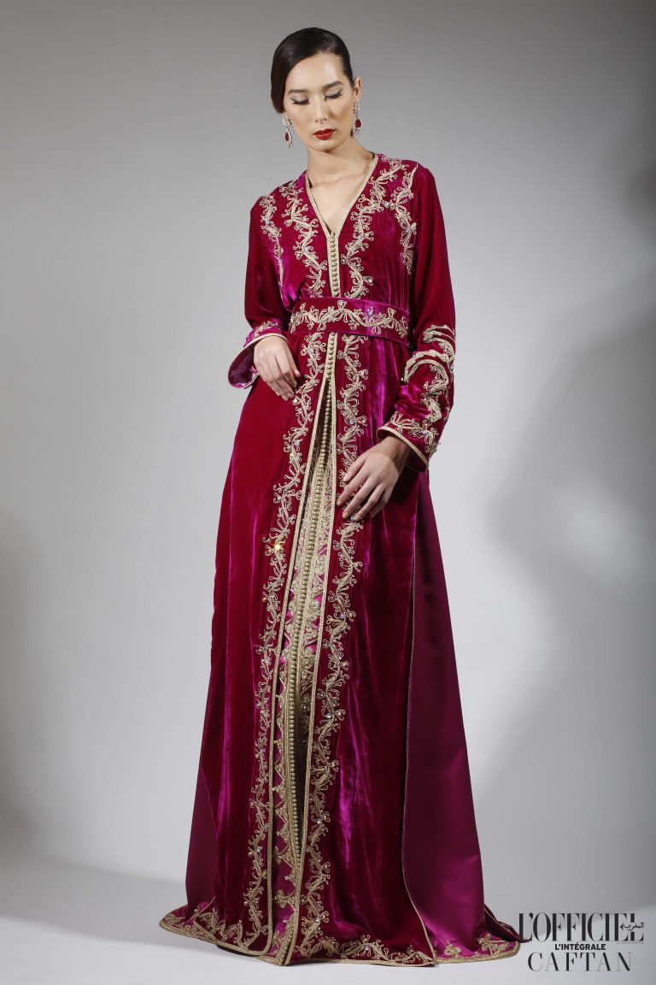
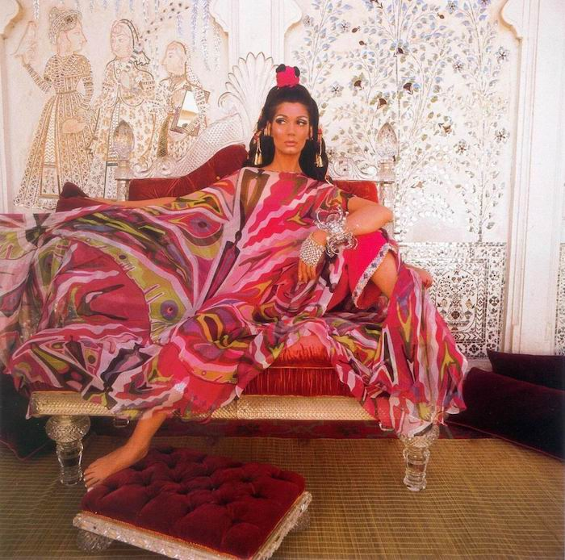
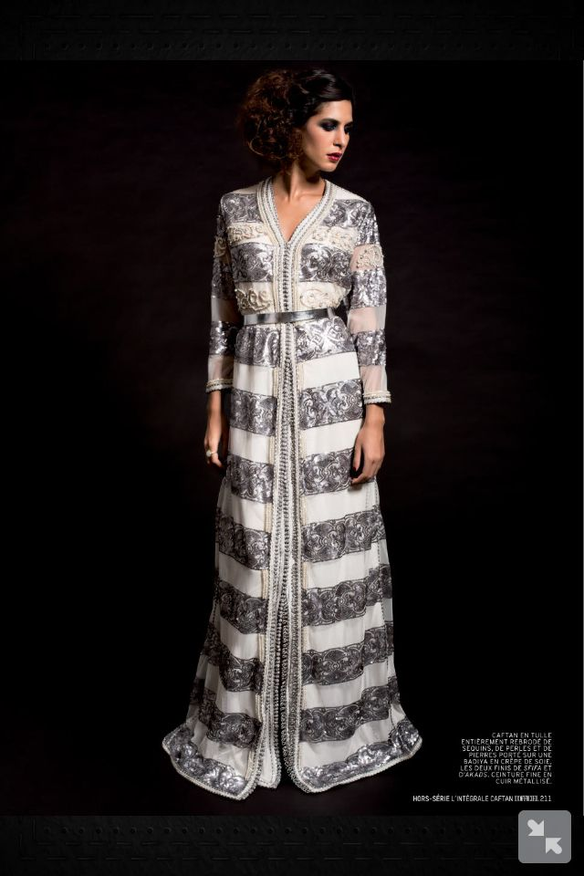
Caftans

Slide 12
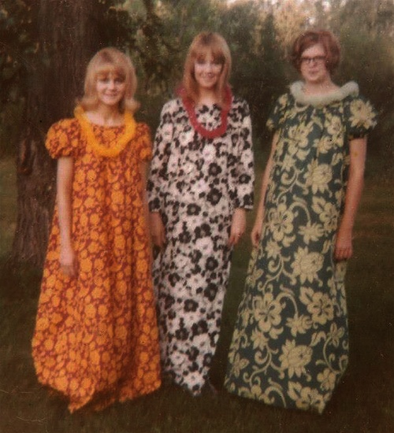

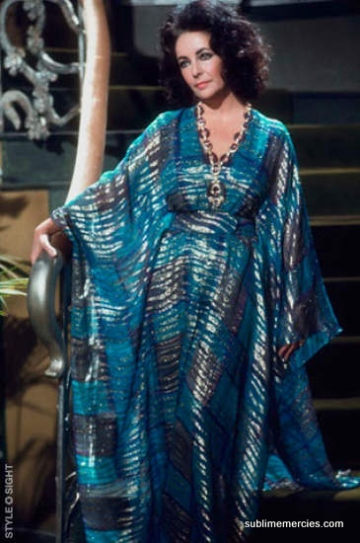
Muumuus

Slide 13
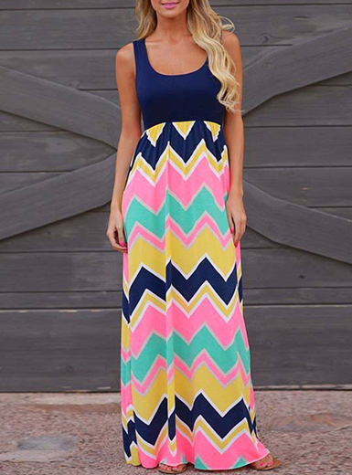
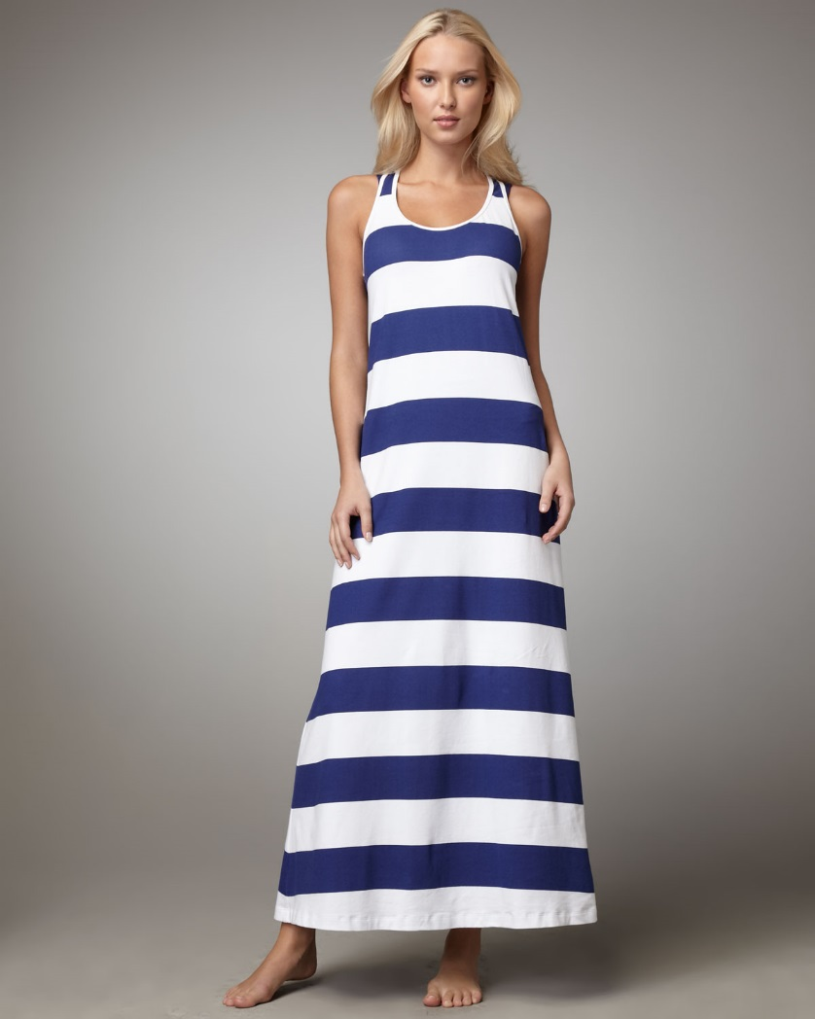
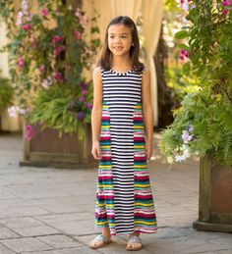
Patterns for Dashwoods: Elinor, Marianne, Margaret?

Slide 14
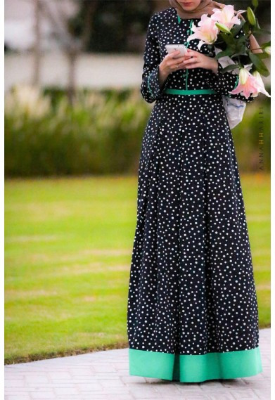
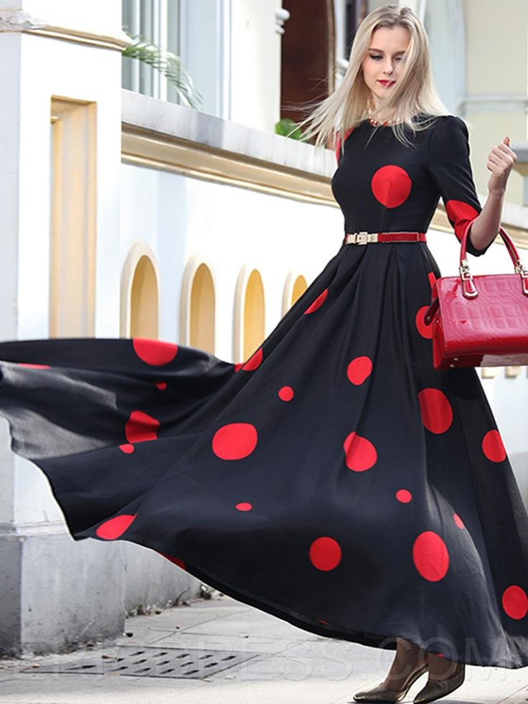
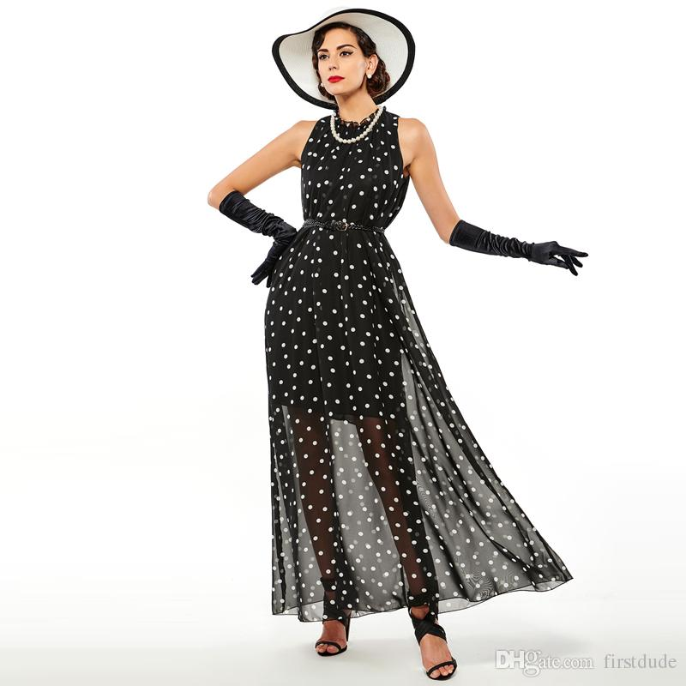
Polka Dot Contrast

Slide 15
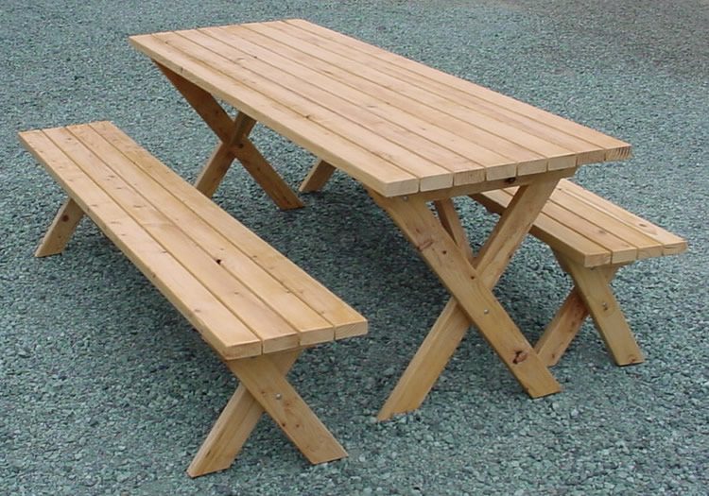
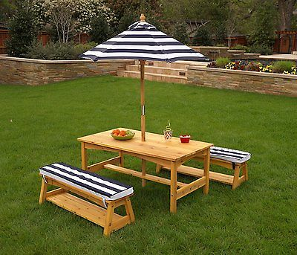
Picnic Table

Slide 16
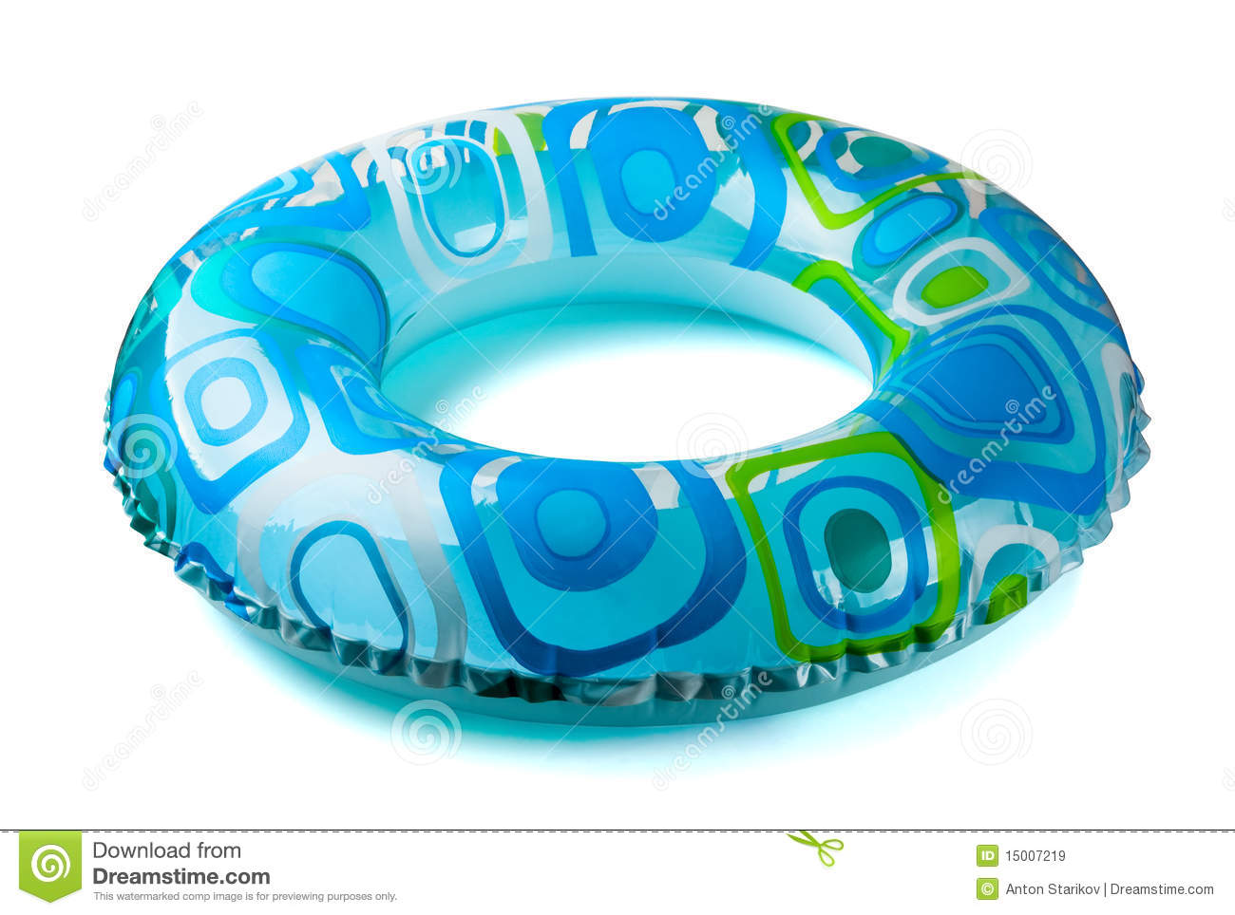
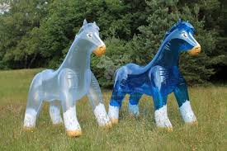
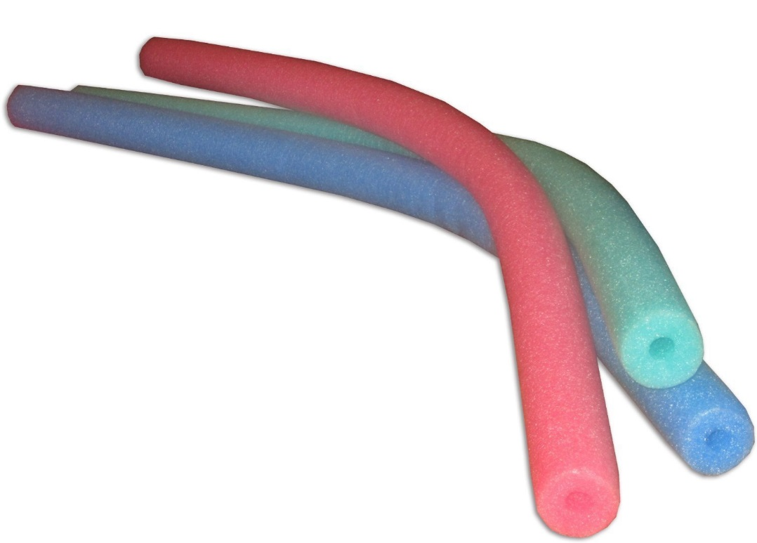
Inflatables, Pool Noodles

Slide 17
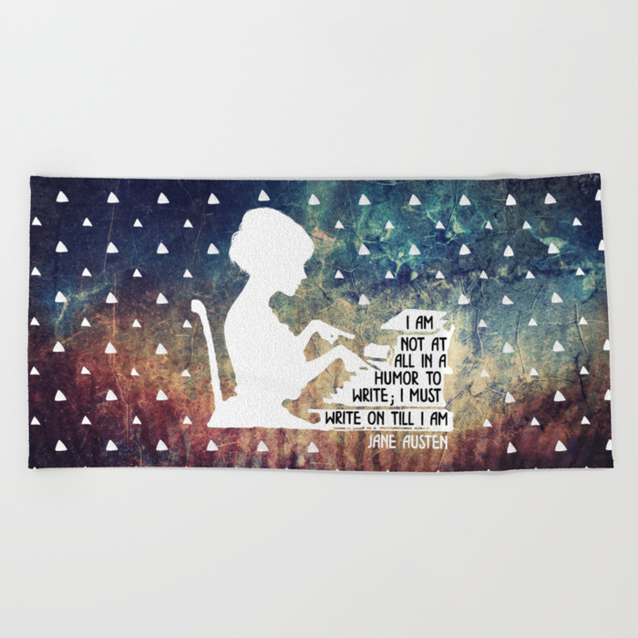
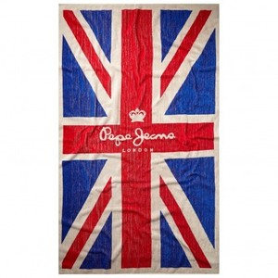
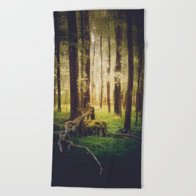
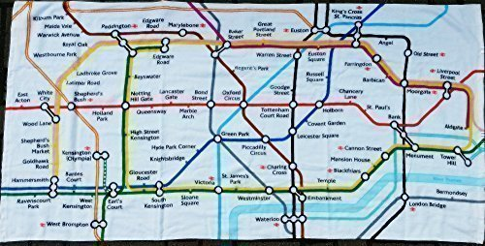
Beach Towels?

Slide 18
Music
I would love to have Beach Boys or Israel Kamakawiwo'ole style arrangements of English ballads (Over the Hills and Far Away; The Wild Rover; What Shall We Do with the Drunken Sailor?) or Cowper hymns
Show calls for Marianne to play the piano. This could be a keyboard. I’d be OK with a ukulele, but it might be weird with the script.
If we stick with piano/keyboard it might be fun for Marianne to go full-on Tori Amos even though that doesn’t fit the beach concept.

